Slide 1
Matthew Ernst
Circuit Analysis
How to Notes
EECT 111
12.15.2017

Slide 2
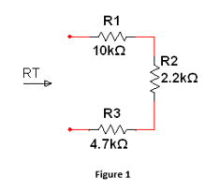
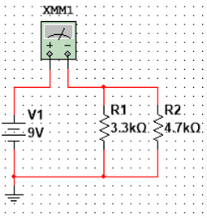
Question 1
Combine multiple resistors in series and parallel
To combine resistors in series, you add them together. To combine them in parallel, it’s a little different. You add the reciprocals of the resistor values and divide that total by 1.

Slide 3
Question 1
Continuing from earlier, 2.2k, 4.7k and 10k are in series. So 2.2k + 4.7k + 10k = 16.9k.
3.3k and 4.7k are in parallel, so 1/((1/3.3k) + (1/4.7k)) = 1.9k.

Slide 4
Question 2
Calculate RT, IT, and PT
You are given a total of six resistors. They are the following values, recorded in Ohms: 25, 250, 50, 100, 100, and 25.
We are going to start with 3, 4, and 5, which are all in series. R345 = 50 + 100 + 100 = 250. Then, we will add 2 into the mix, which now becomes parallel with R345. So R2345 = 1/((1/250) + (1/250)) = 125.
Now, we add 1 and 6 into it, which are now in series with R2345. So 25 + 125 + 25 = 175 Ohms, = RT.
IT is just 1, so by Ohm’s Law, PT = IT * RT = 175 * 1 = 175 = PT.

Slide 5
Question 2
Calculate the nodal voltages, branch currents, and power dissipation
We will start with the nodal voltages. Va = Vs * (R2345 + R6) / RT. Vs in this case = 175, so 175 * (125 + 25) / 175 = 150V.
For Vb, this will be R6 * IT = 25 * 1 = 25V.
For the branch current, we subtract the nodal voltages and divide it by the appropriate resistor values. For I1, this will be equal to (Va – Vb) / R2 = (150 – 25) / 250 = 0.5 amps.
Solving for I2, this is (Va – Vb) / R345 = (150 – 25) / 250 = 0.5 amps.

Slide 6
Question 2
The power dissipation, as mentioned earlier, is 175. But there’s a specific way to calculate this. P1 = IT^2 * R1 = 1 * 25 = 25W.
The power dissipation follows a simple formula: P = I^2 * R. Let’s do the math. P2 = I^2 * R2 = 0.5^2 * 250 = 63W. P3 = I^2 * R3 = 0.5^2 * 50 = 13W. P4 = I^2 * R4 = 0.5^2 * 100 = 25W. P5 = I^2 * R5 = 0.5^2 * 100 = 25W. P6 = I^2 * R5 = 0.5^2 * 100 = 25W.
By adding all these numbers, we get PT = 175W.

Slide 7
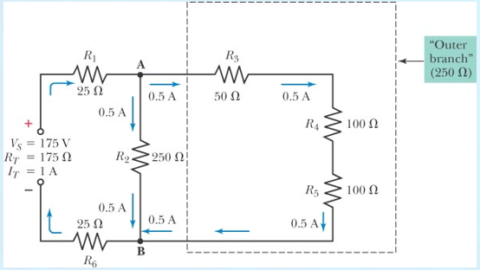
Question 2

Slide 8
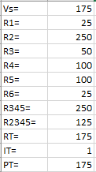
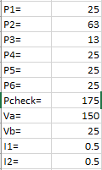
Question 2

Slide 9
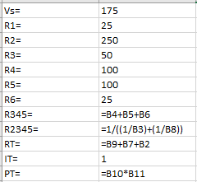
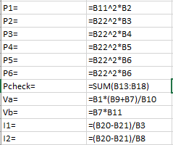
Question 2

Slide 10
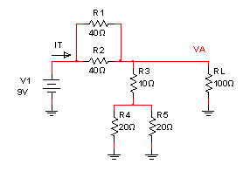
Question 3
How to calculate the Thevenin Resistance and Voltage of a resistor network
In order to do this, you must first know the values of the resistors given.

Slide 11
Question3
The Thevenin Resistance will be calculated by adding resistors 4 and 5, both of which are equal to 20 ohms. The formula for calculating the resistance of these resistors, which are in parallel, is as follows: 1/((1/20)+(1/20)) = 10 Ohms.
To obtain the Thevenin Voltage, we take the Thevenin Resistance, 10, divide it by 20 Ohms, and then multiply that by the voltage, 9. So it would be: (10/20)*9=4.5 volts.

Slide 12
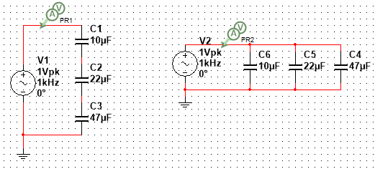
Question 4
How to combine multiple capacitors in series and parallel
In order to add capacitors in a circuit, the laws for doing so are opposite that of a resistor. Combining capacitors in series would require the sum of the reciprocal formula, and combining them in parallel is simply adding them together.

Slide 13


Question 4
Here we can see two different results of combining capacitors, in series and parallel. The results below were gathered via Multisim and Excel.

Slide 14
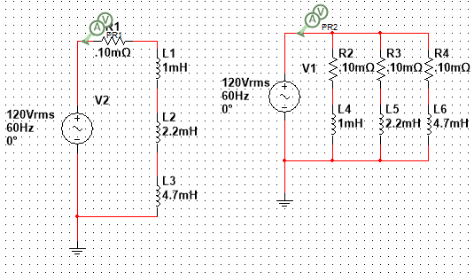
Question 5
How to combine multiple inductors in series and parallel
Combining inductors in series and parallel is the same as combining resistors in series and parallel, but a resistor must be added to the circuit.

Slide 15
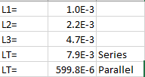
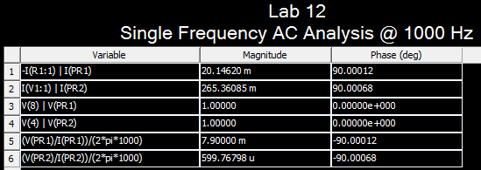
Question 5
Here are the simulated and calculated results of this experiment. Results are shown via Multisim and Excel.

Slide 16
Question 6
Determine XC at a fixed frequency
X=1/(2*pi*1000*0.0001)=1.59

Slide 17
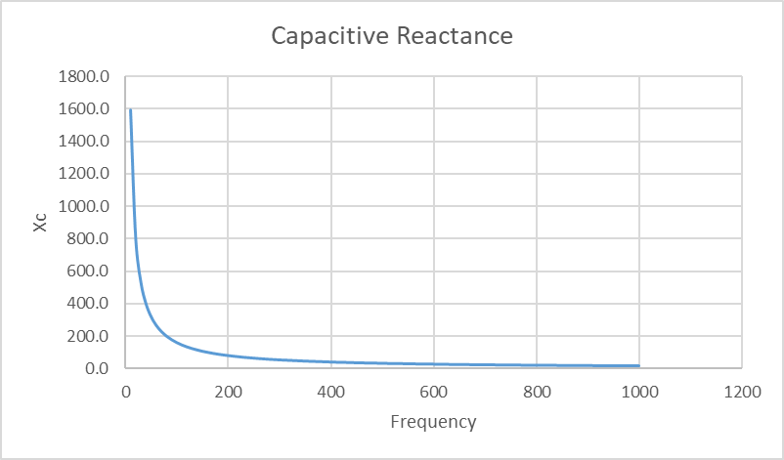
Question 6
Create a graph that shows how XC changes as a function of frequency

Slide 18
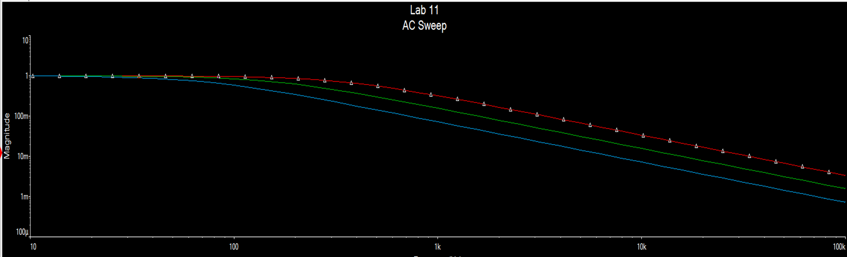
Question 6
Plot the frequency response

Slide 19
Question 7
Determine XL at a fixed frequency
2*pi*1000*0.0001=0.628

Slide 20
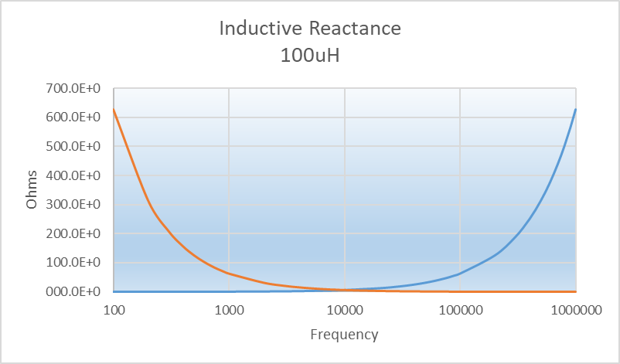
Question 7
Create a graph that shows how XL changes as a function of frequency

Slide 21
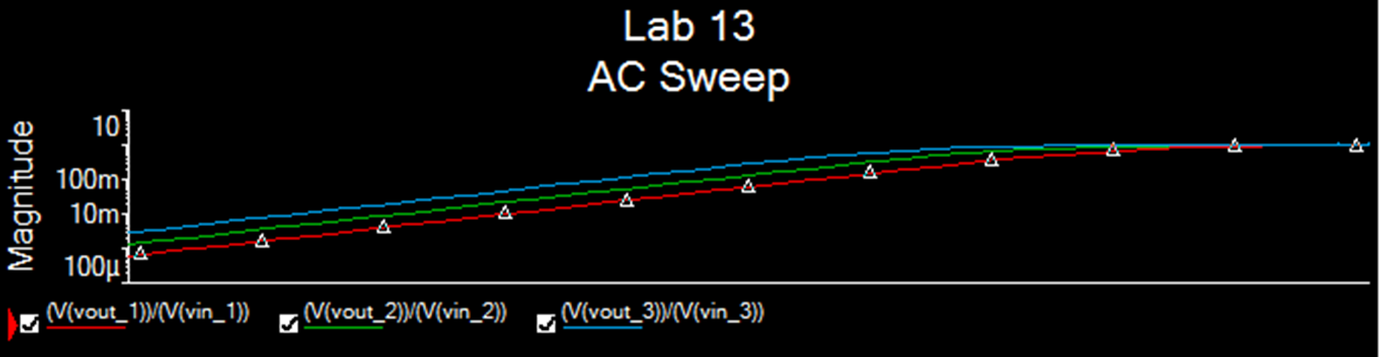
Question 7
Plot the frequency response

